Slide 1
Gradient Descent

Slide 2
In mathematics, gradient descent is a first-order iterative optimization algorithm for finding a local minimum of a differentiable function. The idea is to take repeated steps in the opposite direction of the gradient of the function at the current point, because this is the direction of steepest descent.

Slide 3
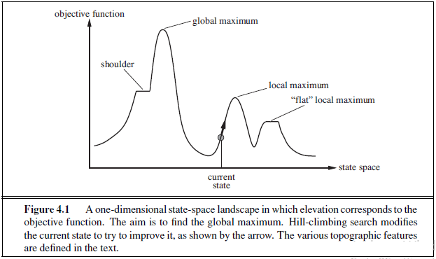
State-Space Landscape

Slide 4
State-space landscape
A landscape has both:
“location” (defined by the state) and
“elevation” (defined by the value of the heuristic cost function or objective function).
Aim is to find
the lowest valley—a global minimum
to find the highest peak—a global maximum

Slide 5
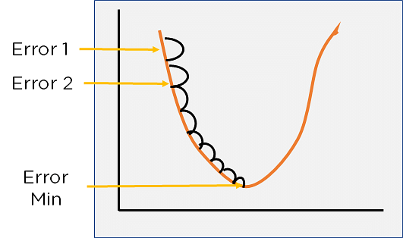
A simple cost function landscape

Slide 6
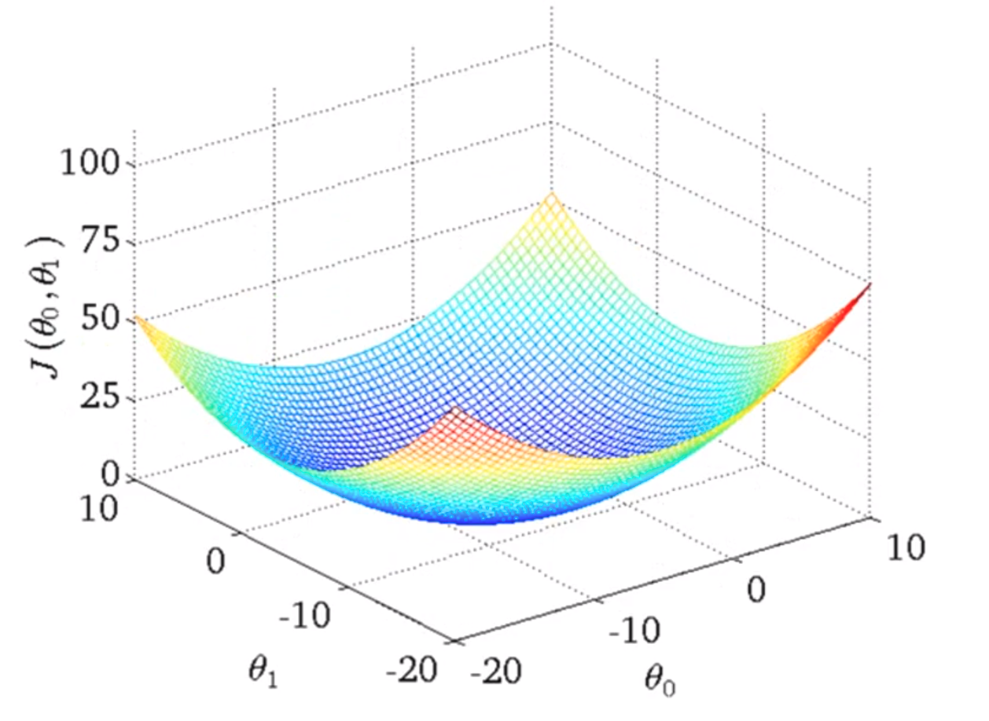
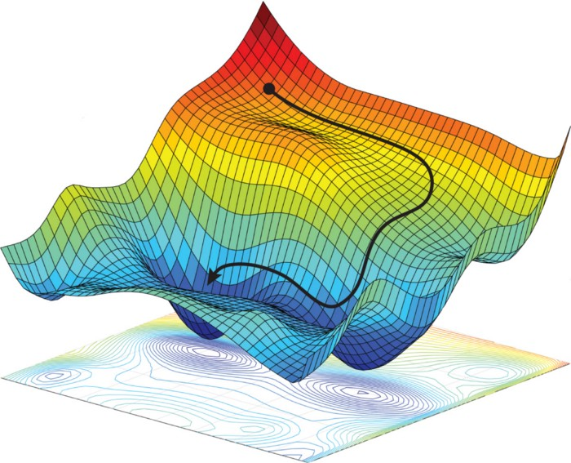
More complex cost functions

Slide 7
Local Search Problems
Given:
a set of states: S = {Xi, . . . . . . , Xm}
an objective function [Eval(Xi)] that returns the goodness of the state
Find the state X* that maximizes the objective function
The new state is close to the previous one in the space of states, hence the name local search.
[Note: Sometimes Eval(Xi) is a cost function instead of an objective function, in this case, we want to find the state X* that minimizes the cost function]

Slide 8
Gradient descent in ML
Gradient descent is an optimization algorithm which is commonly-used to train machine learning models and neural networks
It is an optimization algorithm that is used to minimize a function by iteratively adjusting its parameters
Gradient means slope
PHYSICS: An increase or decrease in the magnitude of a property (e.g. temperature, pressure, or concentration) observed in passing from one point or moment to another

Slide 9
Gradient Descent for Linear Regression
y = mx + c
We want to find m and c
Since it is a regression problem, we can use the Mean Square Error (MSE) as the cost function
MSE= Σ(actual_y - predicted_y)²
n

Slide 10
Parameter update
m = m - α * dMSE/dm
c = c - α * dMSE/dc

Slide 11
Steps
Initialize m and c with any values
Find predicted_y to calculate error
Calculate the gradients of the MSE with respect to m and c. These gradients indicate the direction and magnitude of the steepest increase in the MSE. The gradients are calculated using partial derivatives
Update the values of m and b using the gradients and a learning rate α (step size)
Repeat 2-4 n times, or until the parameters converge to a satisfactory value

Slide 12
MSE= Σ(actual_y - predicted_y)²
n
y = mx + c
dMSE/dm = - 2 * Σ x * (actual_y - predicted_y)
n
dMSE/dc = - 2 * Σ(actual_y - predicted_y)
n

Slide 13
x | y
1 | 3
2 | 5
3 | 7
Assume learning rate is 0.1
1. Initialize m and c with 0
2. Predict y for each point
For (1, 3): predicted_y = 0*1 + 0 = 0
For (2, 5): predicted_y = 0*2 + 0 = 0
For (3, 7): predicted_y = 0*3 + 0 = 0
MSE=? => [(3-0)^2+(5-0)^2+(7-0)^2]/3 = 15.33

Slide 14
3. Calculate the gradients of the MSE with respect to m and c
dMSE/dm = (-2) * [(1) * (3 - 0)]/3 = -2
dMSE/dc = (-2) * [(3 - 0)]/3 = -2
dMSE/dm = (-2) * [(2) * (5 - 0)]/3 = -6.67
dMSE/dc = (-2) * [(5 - 0)]/3 = -3.33
dMSE/dm = (-2) * [(3) * (7 - 0)]/3 = -14
dMSE/dc = (-2) * [(7 - 0)]/3 = -4.67

Slide 15
4. Update m and c
m = m - α * dMSE/dm
c = c - α * dMSE/dc
New m = 0 - 0.1 * (-2 + -6.67 + -14) = 2.267
New c = 0 - 0.1 * (-2 + -3.33 + -4.67) = 1

Slide 16
5. Repeat
Again compute new predictions using new m and c
Recalculate gradients
Update parameters
…….
…..

Slide 17
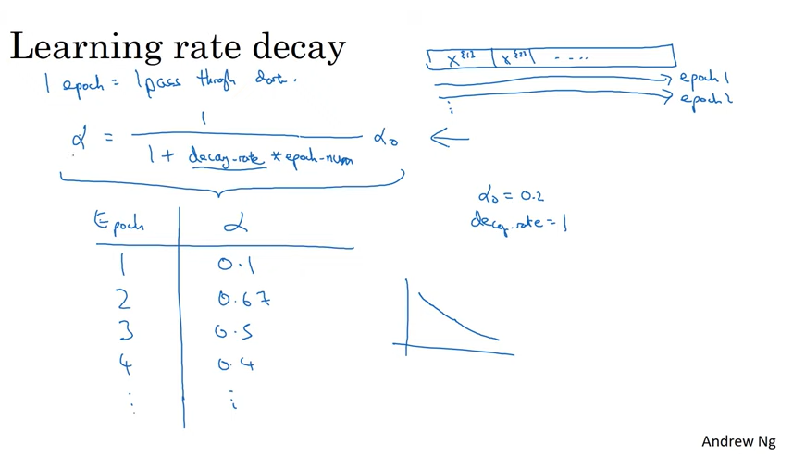

Slide 18
References and additional material
https://conferences.mpi-inf.mpg.de/adfocs-22/material/alina/adaptive-L1.pdf

